Slide 1
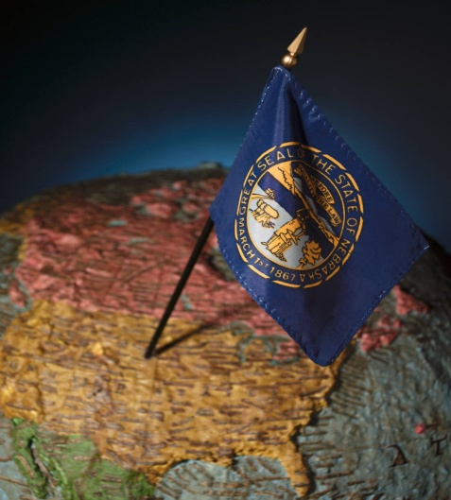
Nebraska Intelligent Transportation Systems and Operations

Slide 2
100,000+ Assists in 11 Years

Slide 3
Nebraska
77,000 square miles
10,000 mile state highway system
450 mile Interstate-80 Corridor
1.8 Million population
Cities: Omaha (500K); Lincoln (250K); Bellevue (50K); Grand Island (50K)
93 counties
20 counties with 20K population
Freight Corridor
World’s Busiest Railway Corridor
Statewide 511
50 DMS (I-80)
60 RWIS
Freeway Sensors (Omaha)
Volunteer Freeway Service Patrol
Automated Ramp Gates
MDSS
CCTV

Slide 4
Expanding Role of Highway Agencies
Incident Management
Work Zones
Weather Management Systems
Traffic Management and Operations
Planned Event Management
Homeland Security
Alerts
Multi-State Operations
Travel Information
Commercial Vehicles and Freight

Slide 5
Improved Statewide and Multi-State Operations
Optimize the performance of the transportation system
Includes system traffic detection –sensors
Surveillance -cameras
Coordinated arterial and freeway operations –alternate routing, signal phasing
Automated work zones
Road weather management
Electronic clearance
Weigh-in-Motion
Traveler information systems
Incident Management
Homeland Security -All Hazards
Corridor Management
Multi-State Operations

Slide 6
Road Weather Information Systems
More than 70 RWIS statewide
Nearly 50% of traffic delay is weather-related
Nebraska’s 511 system was the first nationwide to deliver 30-mile surface weather reports

Slide 7
Dynamic Message Signs (DMS)

Slide 8
NDOR District 2 Operations Center

Slide 9
District 2 Operations Center
Need for DOC identified in 1995
7 Rural DOCs
$1.8 million core and shell
$1.2 Million ITS finish
Omaha DOC has 8,000 square feet
Co-location with NSP Troop A Dispatch

Slide 10
Safe, Quick Clearance

Slide 11
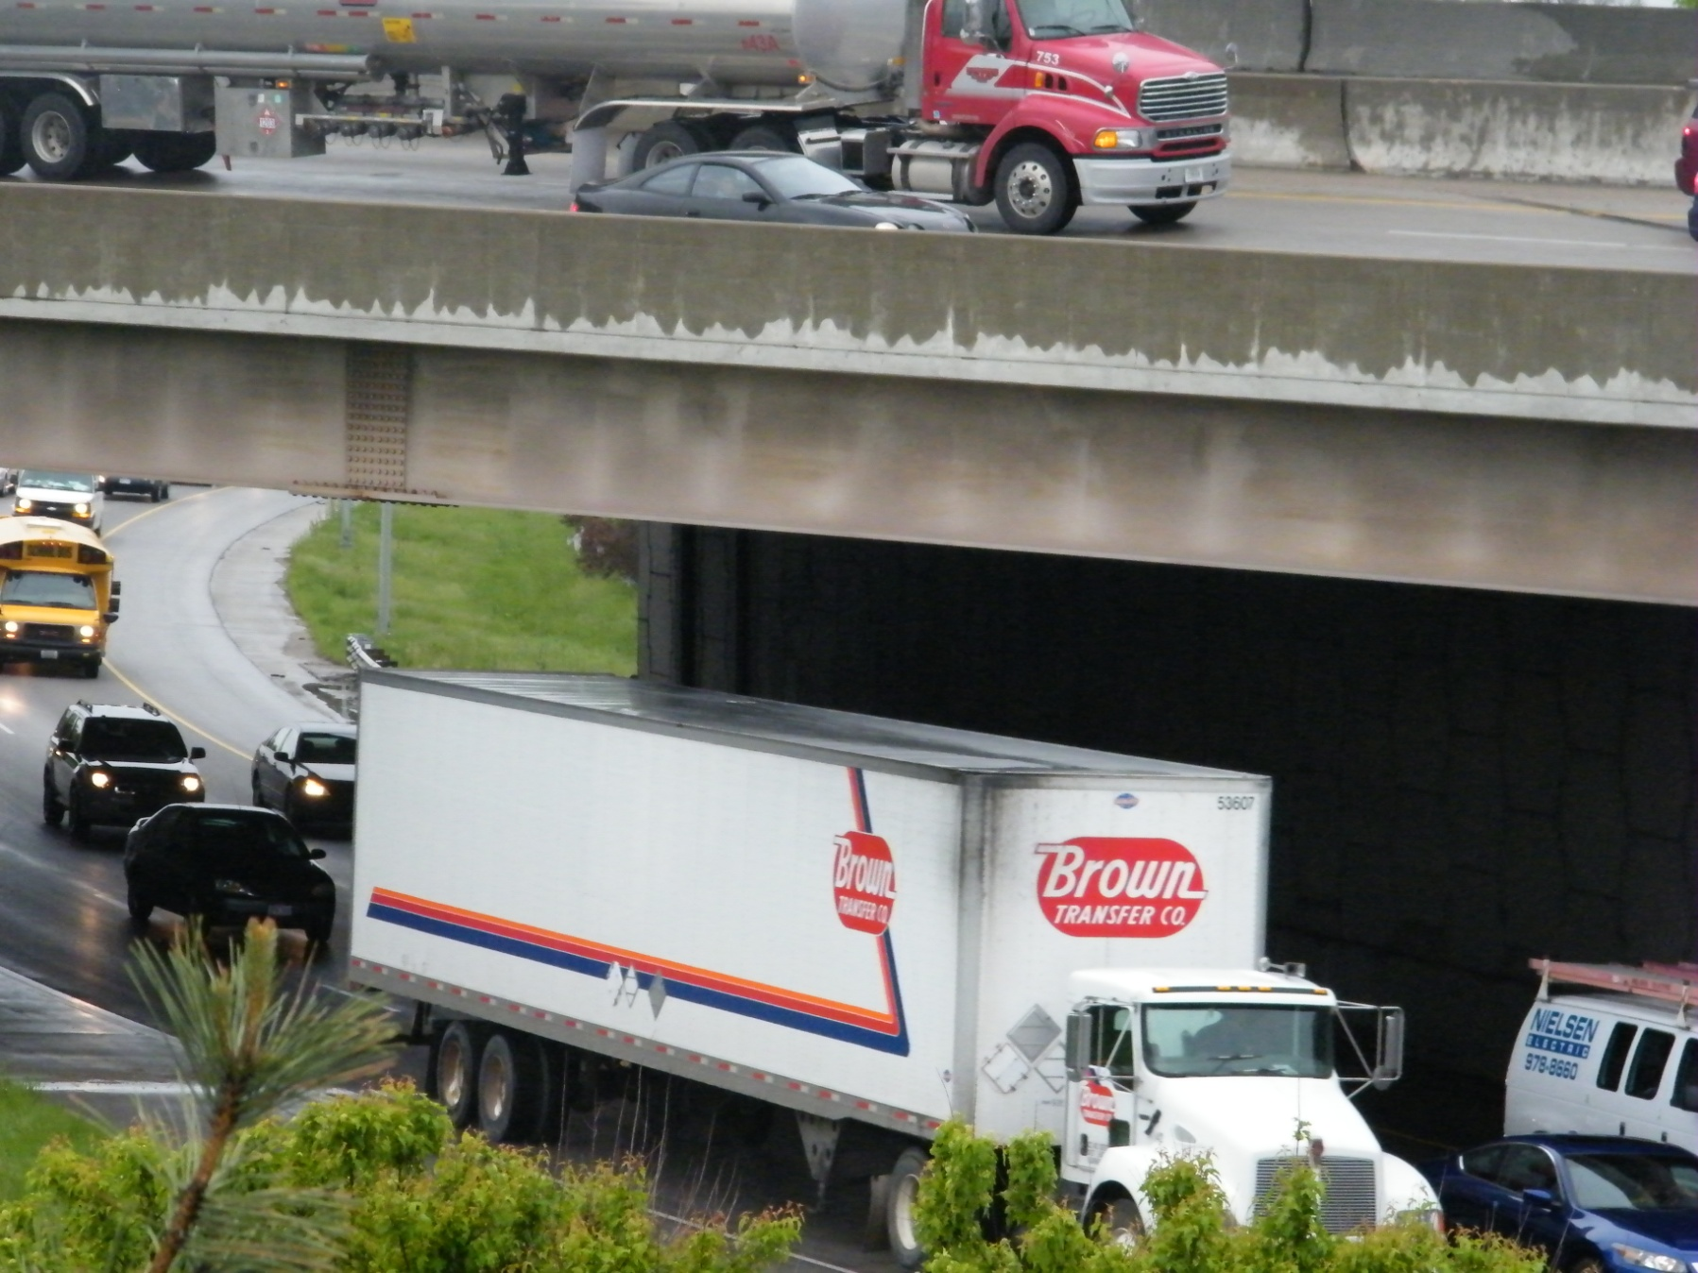

Slide 12
Travel Information

Slide 13
Traveler Information Portal

Slide 14
Rural DOCs

Slide 15
Rural Operations

Slide 16
Distributed Field Devices

Slide 17
Commercial Vehicle Operations

Slide 18
Cameras, Sensors and Automated Ramp Gates

Slide 19
I-80 at Missouri River

Slide 20
Low Tech Travel Information

Slide 21
Interstate-80 Winter Operations Coalition
Jim McGee MPA
Jim.McGee@Nebraska.gov
402-610-0074
October 26-27, 2010
Reno, Nevada

